Slide 1

ACCESS TO CARE
A SURVEY FROM EHA
2008-2013

Slide 2
Background
Primary headaches, migraine in particular, are underdiagnosed.
Migraine patients receive a suboptimal medical approach even in developed countries.
EHA believes that a better picture of the problem will contribute to find appropriate solutions.

Slide 3
Aim
This is the second run of a survey that was FIRST conducted by EHA - in collaboration with its members – in 2008 with the aims
to witness barriers in the access to care for headache sufferers
to provide solid ground for involving decision makers
and
to suggest possible solutions.

Slide 4
Methods
Two questionnaires were devised and used:
Questionnaire 1, for representatives of member organizations
Questionnaire 2, for members of the national organizations

Slide 5
Questionnaire 1
Representatives of national organizations

Slide 6
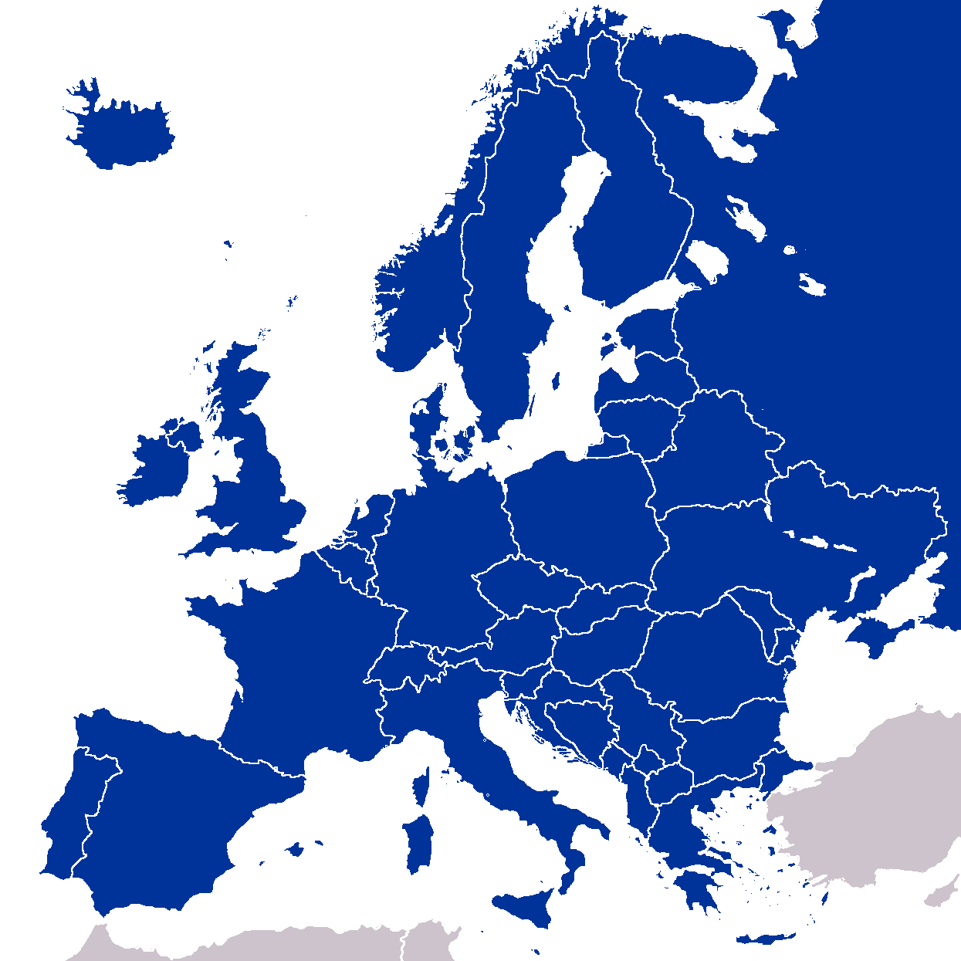
Twelve associations or patients’ representatives from 11 countries participated in the survey:
Finland
Iceland
Ireland
Italy
Lithuania
Netherlands
Romania
Sweden
Spain
Serbia
UK
Finnish Migraine Association
Migrensamtokin
Migraine Association of Ireland
Al.Ce. Group, CIRNA Foundation
No formal Organisation
Vereniging van Hoofdpijnpatiënten
Headache Society
Svenska migränförbundet
Asociación Española de Pacientes con Cefalea
Serbian Migraine Association
The Migraine Trust
Migraine Action

Slide 7

Can headache sufferers access reliable and accurate headache/migraine information in your national language?
Country/Organisation | Yes | No
Ireland | X
Italy | X
Holland | X
Sweden | X
UK | X
Spain | X
Iceland | X | X
Romania | X
Lithuania |  | X
Serbia | X
Finland | X
Total | 10 | 2

Slide 8

Are there Specialist Headache Centre (Headache/Migraine Clinic) in your Country?
Country/Organisation | Yes | No
Ireland | X
Italy | X
Holland | X
Sweden | X
UK | X
Spain | X
Iceland |  | X
Romania |  | X
Lithuania |  | X
Serbia | X
Finland |  | X
Total | 7 | 4

Slide 9

If yes, how many?
Country/Organisation | Number
Ireland | 5
Italy | 190
Holland | 34
Sweden | Missing
UK | 55
Spain | 5
Iceland
Romania
Lithuania
Serbia | 3
Finland

Slide 10

Do patients in your country have the right to choose which specialist doctor they see and which hospital they attend?
Country/Organisation | Yes | No
Ireland |  | X
Italy | X
Holland | X
Sweden | X
UK | X | X
Spain | X
Iceland | X
Romania |  | X
Lithuania |  | X
Serbia | X
Finland | X
Total | 8 | 4

Slide 11

Which of the following would be the more TYPICAL waiting time in your country for an appointment with a headache/migraine specialist if the condition is NOT ACUTE?
Country/Organisation | Within 3 mos | More than 3 mos | I am not sure
Ireland |  | X
Italy |  | X
Holland | X
Sweden |  | X
UK |  |  | X
Spain | X
Iceland | X
Romania | X
Lithuania | X
Serbia | X
Total | 6 | 3 | 1

Slide 12

Are NSAIDs subsidized by your national health system when prescribed for migraine/headache?
Country/Organisation | Yes | Partially | No | I am not sure
Ireland |  | X
Italy |  |  | X
Holland |  |  | X
Sweden |  | X
UK |  | X
Spain |  | X
Iceland |  |  | X
Romania |  | X
Lithuania |  | X
Serbia |  |  |  | X
Finland |  | X
Total | 0 | 7 | 3 | 1

Slide 13
Are Triptans subsidized by your national health system when prescribed for migraine/headache?
Country/Organisation | Yes | Partially | No | I am not sure
Ireland |  | X
Italy |  | X
Holland | X
Sweden |  | X
UK |  | X
Spain |  | X
Iceland |  | X
Romania |  | X
Lithuania |  | X
Serbia |  | X
Finland |  | X
Total | 1 | 10 | 0 | 0

Slide 14
Are prophylactic medications for migraine/headache subsidized by your national health system when prescribed for migraine/headache?
Country/Organisation | Yes | No | Some of them | I am not sure
Ireland |  |  |  | X
Italy |  |  | X
Holland | X
Sweden |  |  | X
UK | X
Spain |  |  | X
Iceland | X
Romania
Lithuania |  |  | X
Serbia |  | X
Finland |  |  | X
Total | 3 | 1 | 5 | 1

Slide 15

Does your organisation consider the access to care and good management of migraine in your country acceptable?
Country/Organisation | Yes | No
Ireland |  | X
Italy |  | X
Holland | X
Sweden |  | X
UK |  | X
Spain |  | X
Iceland |  | X
Romania | X
Lithuania
Serbia | X
Finland | X | X
Total | 4 | 7

Slide 16
Questionnaire 2 for members of the national organizations

Slide 17
Twelve members of EHA participated in the survey:
France
Germany
Iceland
Ireland
Italy
Lithuania
Romania
Serbia
Spain
Sweden
The Netherlands
UK
1935
questionnaires collected

Slide 18
Gender & age distribution
Years

Slide 19
Headache type

Slide 20
Access to reliable and accurate information on headaches?
Source for information
%
Possible multiple choice answers

Slide 21

Are you aware of programmes in your country to identify migraine in children?

Slide 22
Do you know about the existence of headache centres?
Mean latency from the moment headache developed is generally very long,
in some cases DECADES
2008 Edition
Mean = 12.8 years in 2008 survey

Slide 23
How did you find out about a headache centre?
%

Slide 24
Have you had the right to choose which specialist doctor you see and which hospital you attend?

Slide 25
In your experience, can patients have easy access to information that allows them to see which hospitals/clinics are best for head pain?
Such information might, for instance, be about treatment results, complication rates, etc.

Slide 26
Have you been referred to a headache specialist?
If you answered yes: How were you referred?
%

Slide 27
How long did you wait for the appointment with the specialist?

Slide 28
Do you regularly see a health professional for treatment?
%
2008 Edition

Slide 29
What type of acute medication do you take?
Do you take prophylactic medications?
%
2008 Edition

Slide 30
Are you satisfied with the management and treatment of your headache condition?
%

Slide 31
Conclusions from the survey
Migraine is the major type of headache among responders;
Migraine and other headache disorders deserve more attention from health professionals;
Most frequently involved health professionals are not headache specialists;
The majority of the responders are not satisfied with treatment and management;
Many patients are unaware of the existence of headache centres and those who are, experience difficulties in gaining access to them;
Only a minority of patients is receiving prophylactic medication

Slide 32
Conclusions from the survey
There is still much work to do;
Isolated efforts from the individual national associations might not be enough;
There is an obvious need for a coordinated European action to
educate patients and doctors,
increase awareness on headache,
improve access to care,
improve care quality.

Slide 33

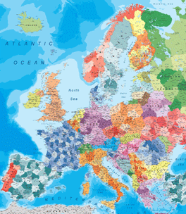




EUROPEAN
PARLIAMENT
EHA
INTERNATIONAL
HEADACHE SOCIETY
More?

Slide 34
EHA MEMBER ORGANISATIONS
1. AEPAC (Asociación Española Pacientes con Cefalea) – Spain
2. Alleanza Cefalalgici – CIRNA Foundation – Italy
3. Associazione Italiana per la lotta contro le Cefalee (AIC) – Italy
4. Belgian Migraine Association – Belgium
5. Dutch Headache Patient Association - The Netherlands
6. Finnish Migraine Association – Finland
7. German Green Cross - Germany
8. Icelandic Migraine Association (Migrensamtokin)
9. Migraine Action Association – UK
10. Migraine Action Luxembourg – Luxembourg
11. Migraine Association of Ireland – Ireland
12. Norwegian Migraine Association – Norway
13. Swedish Migraine Association – Sweden
14. Swiss Migraine Action – Switzerland
15. Serbian Migraine Association – Serbia
16. Austrian Self-help group for headache patients – Austria
17. Migraine Trust – UK
18. Russian Headache Association - Russia
19. Danish Migraine and Headache Association - Denmark
20. Association Française Contre L’Aglie Vasculaire de la Face – France
21. Bundesverband der Clusterkopfschermz-Selbsthilfe-Gruppen - Germany
22. Asociatia Headache Society - Romania

